Slide 1
Predicting company got bankrupt
Kalpa subbaiah
sudHARANI R
ARAVIND

Slide 2
BUSINESS PROBLEM
Based on the various financial ratios need to predict whether the company got bankrupt in the subsequent years or not.

Slide 3
METHODOLOGY
Machine Learning Algorithm:
C5.0
Rpart
Knn
Random Forest
Performance Metrics:
Confusion metrics
F1 Score

Slide 4
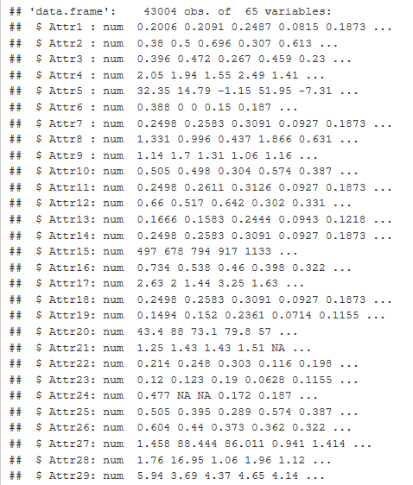
DATA SOURCE

Slide 5
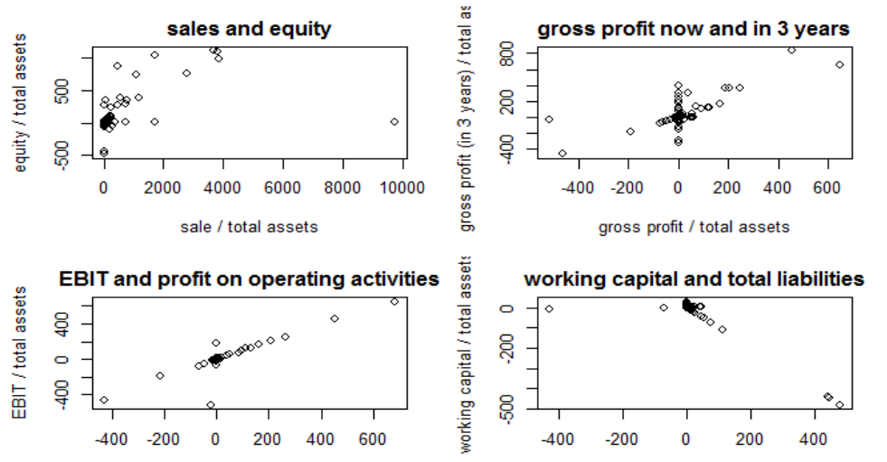
Data Understanding

Slide 6
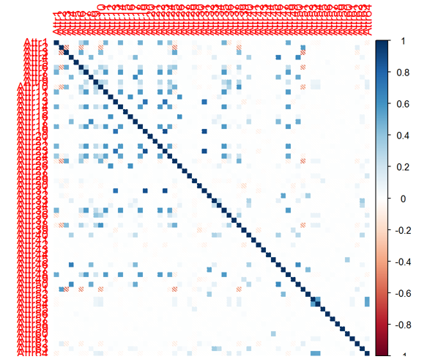
Correlation in Data

Slide 7

Methodology
Data Preprocessing:
Remove Class Imbalance
Impute NA’s
Feature engineering
Standardize the data
Applied modeling
Evaluated using confusion metrics

Slide 8
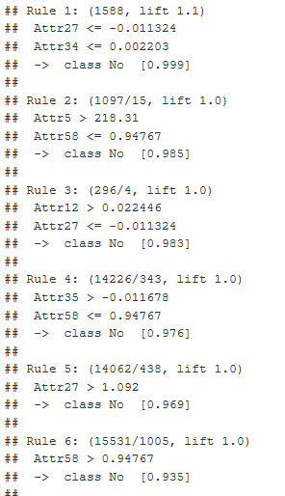
Rules from C5.0 trees

Slide 9
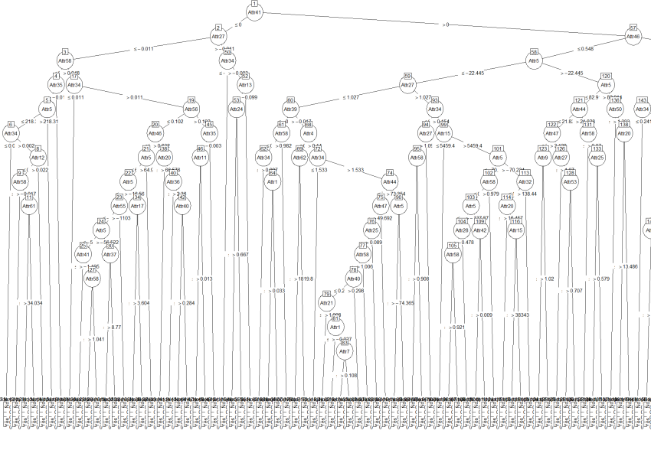
C5.0 tree plot

Slide 10
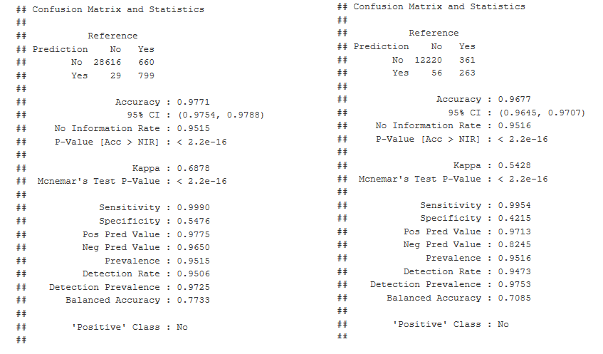
C5.0 tree Confusion Matrix

Slide 11
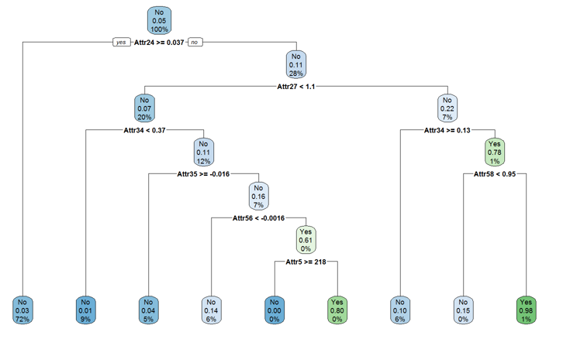
Rpart Tree

Slide 12
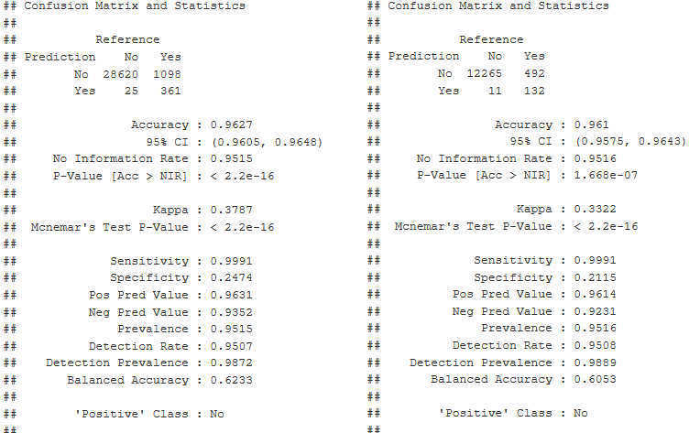
Rpart Confusion Matrix

Slide 13
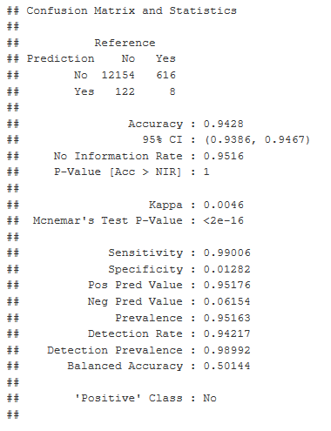
KNN Model

Slide 14
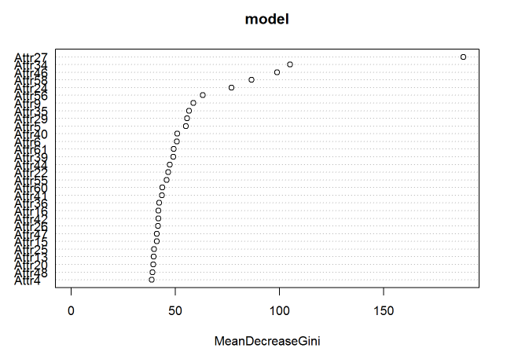
Random forest Important Variables

Slide 15
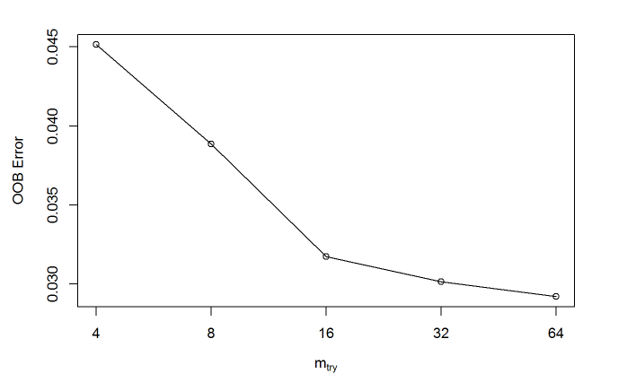
Random forest Tuning

Slide 16
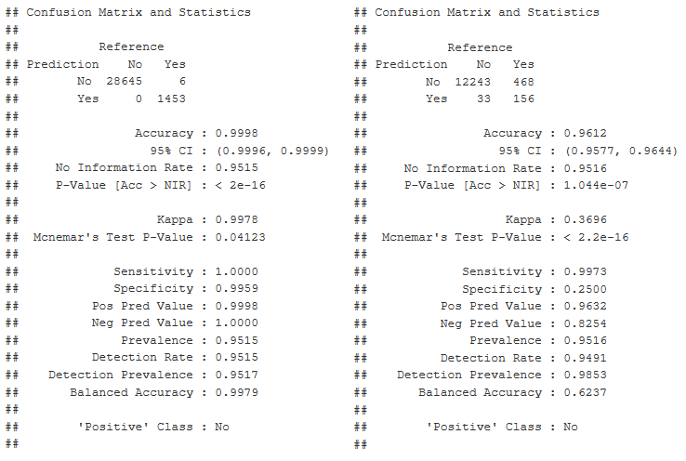
Random forest CONFUSION MATRIX

Slide 17
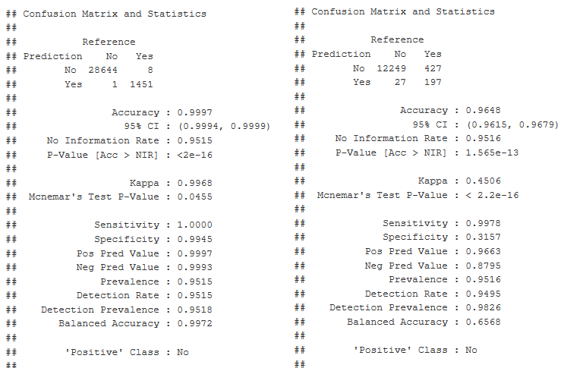
Random forest IMPORTANT VARIABLES

Slide 18
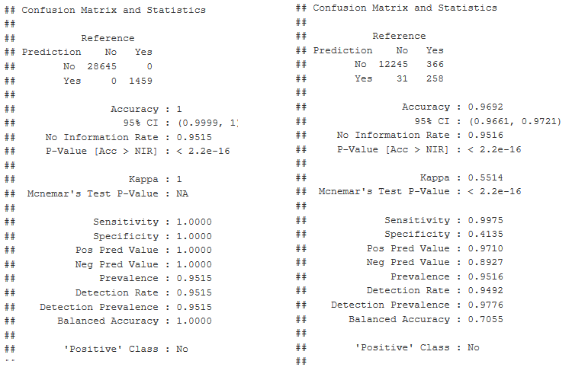
Random forest TUNED CONFUSION MATRIX

Slide 19
Evaluation Metrics Comparison
MODEL | RECALL | PRECISION | F1-SCORE
C5.0 | 0.99 | 0.42 | 0.983
Rpart | 0.99 | 0.21 | 0.979
Knn | 0.99 | 0.95 | 0.970
Random Forest | 0.99 | 0.96 | 0.979
Random Forest (Imp Variable) | 0.99 | 0.96 | 0.981
Random Forest (Tuned) | 0.99 | 0.97 | 0.984

Slide 20
Q & A

